Slide 1
Standing Desk control using Hand Gestures
Matthew Knox
COSC428

Slide 2
Introduction
The Goals:
Control the height of a standing desk using hand gestures
Detect number of fingers raised on a hand
Detect pose of hand
Perform classifications with a low quality and inexpensive camera
Gesture control gives the ability to control the desk height without using switches on the desk
Interaction with the desk is more natural (and fun)

Slide 3
Prior Research
One paper proposed a method for increasing the accuracy of face detection using skin tones in HSV colour space [1].
Handy, a glove based gesture recognizer achieved up to 98.64% accuracy in recognising hand gestures [2].
The first version of the Kinect camera was capable of recognising gestures at 90.6% accuracy using its depth based sensor [3].
The Intel Realsense SDK uses a ‘centre of gravity’ calculated from depth to find the centre of an object. Based on that point it can calculate a pose with up to 85% accuracy [4][5].
[1] V. Bhat and J. Pujari, “Face detection system using HSV color model and morphing operations,” September 2013. [Online]. Available: http://inpressco.com/wp-content/uploads/2013/09/Paper39200-204.pdf. [Accessed 29 April 2016].
[2] L. Lamberti and F. Camastra, "Handy: A real-time three color glove-based gesture recognizer with learning vector quantization," Expert Systems with Applications, vol. 39, pp. 10489-10494, 2012.
[3] Z. Ren, J. Meng, J. Yuan and Z. Zhang, “Robust Hand Gesture Recognition with Kinect Sensor,” Proceedings of the 19th ACM international conference on Multimedia, pp. 759-760, 2011.
[4] T.-H. Tsai, C.-C. Huang and K.-L. Zhang, “Embedded virtual mouse system by using hand gesture recognition,” Consumer Electronics - Taiwan (ICCE-TW), pp. 352-353, 6 August 2015.
[5] Intel, “Hand Tracking Tutorial from IDF 2015 Intel RealSense Lab,” 21 8 2015. [Online]. Available: https://software.intel.com/sites/default/files/managed/7b/89/SFTL006_100.docx. [Accessed 1 4 2016].

Slide 4
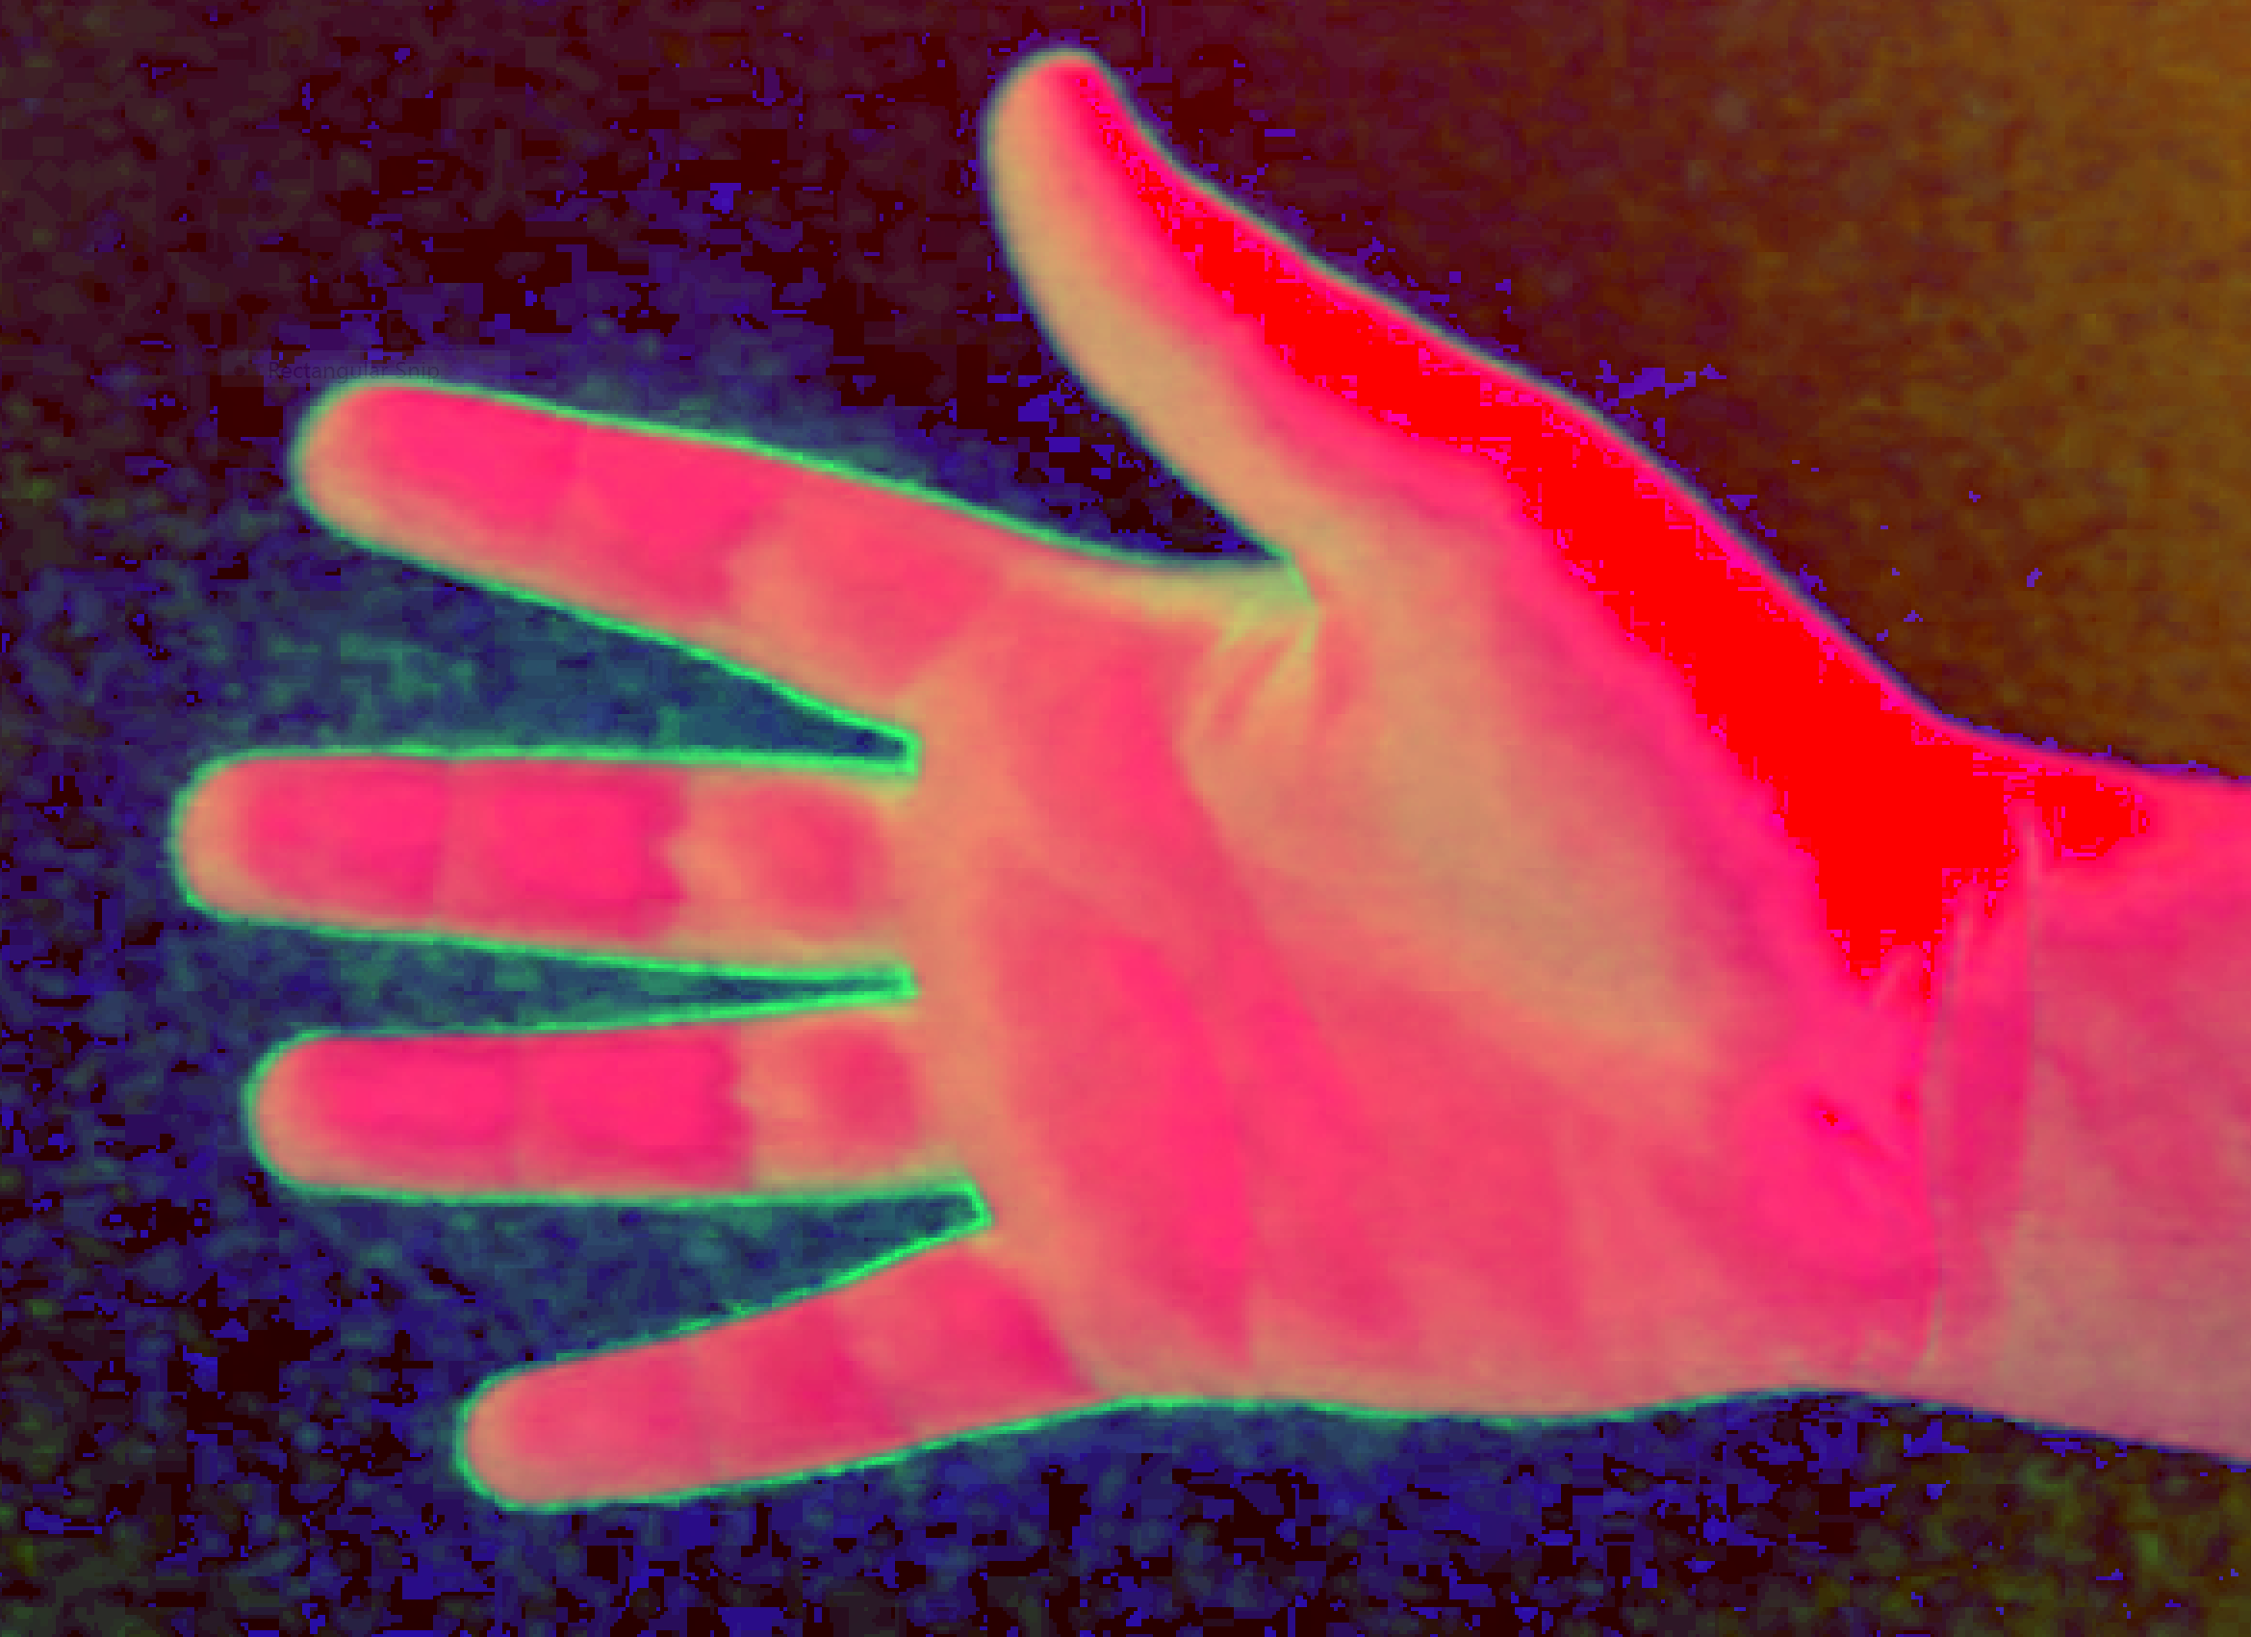
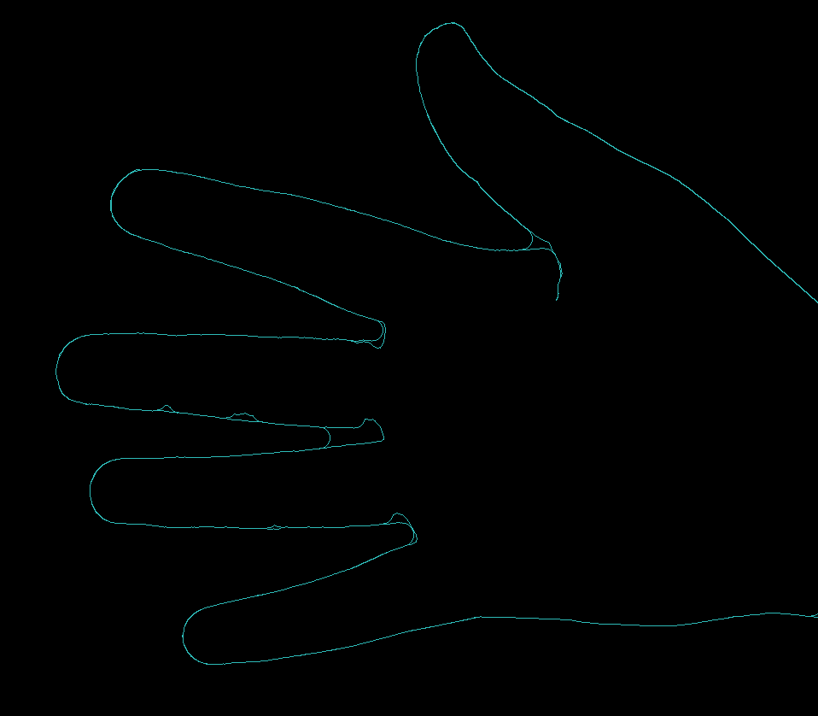
Method
Convert image to skin colour sensitive colour space (HSV)
Use a Gaussian mixture based model to do background subtraction
Edge detection to extract the hand

Slide 5
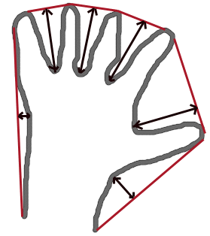
Method
Use convex hull to detect convexity defects and determine number of fingers
Average angle between furthest points on the convex hull to get hand pose
Overall improves on previous solutions by working with a lower quality camera and combining a range of techniques for background subtraction and noise reduction

Slide 6
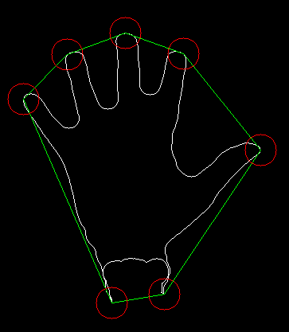
Results
Hand gestures - overall 86% success rate
Test | Successful Tests | Failed Tests | Percentage
No hand in frame | 250 | 0 | 100%
No fingers raised | 93 | 14 | 87%
1 Finger | 79 | 80 | 48%
2 Fingers | 72 | 68 | 52%
3 Fingers | 239 | 42 | 85%
4 Fingers | 199 | 47 | 81%
5 Fingers | 206 | 21 | 91%
Hand Pose - overall 93% success rate
Test Angle (approx) | Successful Tests | Failed Tests | Percentage
45° | 18 | 2 | 90%
90° (up) | 20 | 0 | 100%
135° | 19 | 1 | 95%
225° | 19 | 1 | 95%
270° (down) | 20 | 0 | 100%
315° | 16 | 4 | 80%

Slide 7
Conclusion and Future Research
Method has an 81% success rate on hand gestures and 93% on hand pose
Accuracy is less than the Kinect camera (mean accuracy of 90.6% in one study), but camera was comparatively low quality.
HSV increased the accuracy of detection as was suggested by prior research
Tests were conducted in controlled conditions with a single, stationary camera
Would perform further testing in a real world environment and implement full skin tone filtering rather than just changing colour space

